Slide 1
Final Presentation:
Automated Traffic Light Stop IoT System
INCLUDES: Problem Statement, Rationale, Block Diagram, Flowchart, Results, Evaluation, and Limitations
BY: CONOR POWER, DANIEL COLLINS., SCOUT CASE, JAMES TOMPKINS

Slide 2
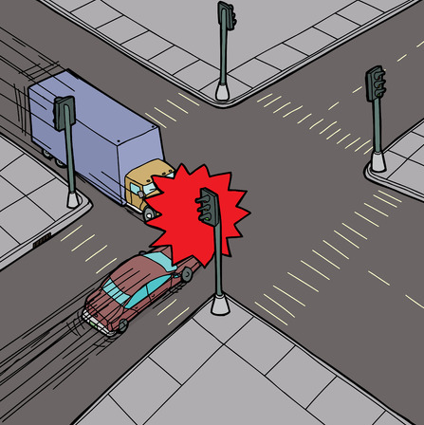
Problem Statement
People misjudge how quickly or slowly traffic lights turn
Most accidents occur at intersections
Most traffic lights have unique timing
https://www.tariolaw.com/determining-fault-in-intersection-car-accidents/

Slide 3
RATIONALE
Determining our connection standard we would like to use
MQTT publishers and subscribers more practical
Faster connection and data retrieval
Notes:
Originally, we had planned on using Bluetooth Low Energy beacons to retrieve the traffic light status from a HTTP Web Page. However, from doing last weeks lab on MQTT Publishers and Subscribers, we have decided this would be a more logical and practical way of parsing the state of the traffic lights. The MQTT approach should also be faster to connect to and retrieve the data than the BLE approach.

Slide 4

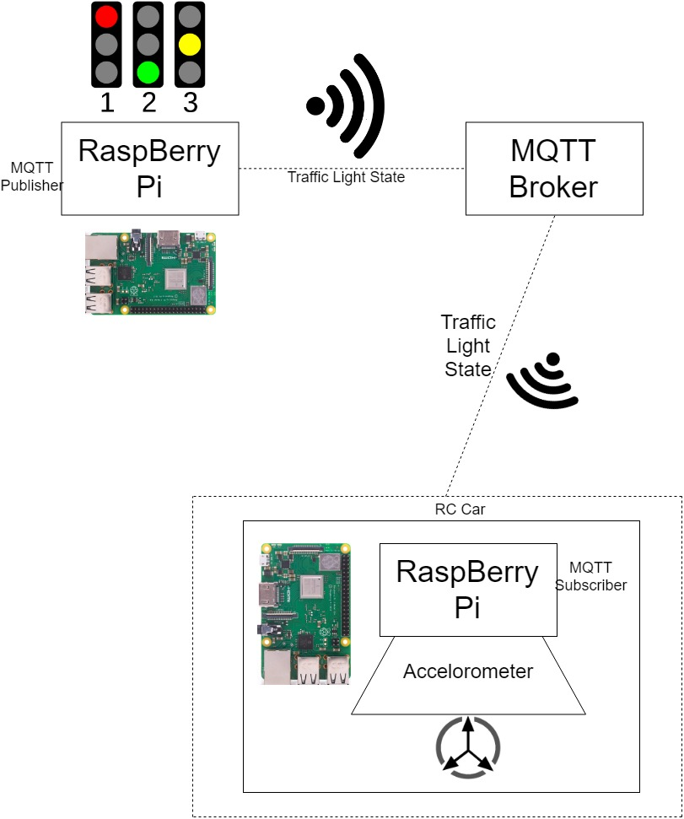
BLOCK DIAGRAM:
The Raspberry Pi exports state
The Raspberry Pi car is constantly searching for new data
Both Raspberry Pi’s are connected to MQTT broker and receive next decision data from it

Slide 5
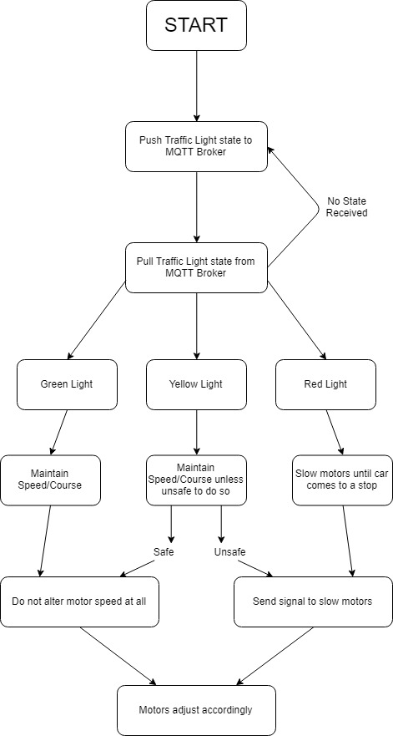
FLOW CHART
Raspberry Pi Car constantly looks for MQTT
When connected, the Pi receives traffic light state
Raspberry Pi car decides next action based on traffic light state

Slide 6
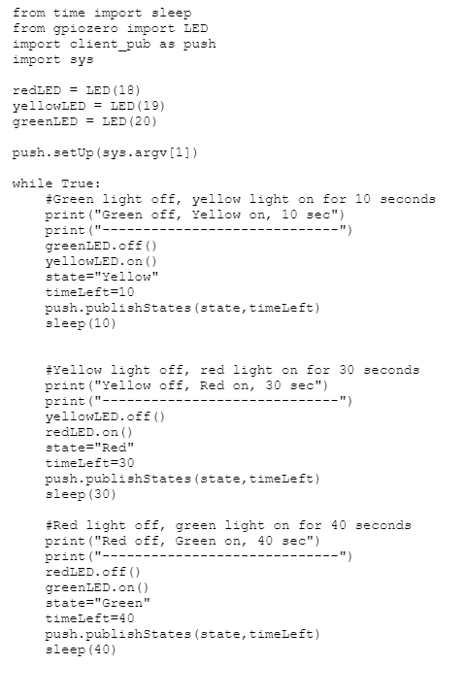
Traffic Light Code:
Has certain timings for each traffic light
Light states are sent to MQTT server
States are either Green, Yellow or Red
Determines the car’s outputs

Slide 7
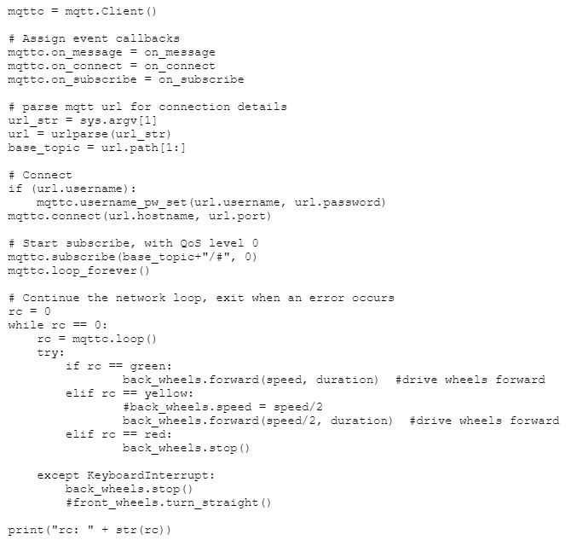
Raspberry Pi Car Code:
Subscribes to the MQTT server
Pulls down the information from the traffic light
Traffic light state will determine the cars actions
Car constantly receives status of light

Slide 8
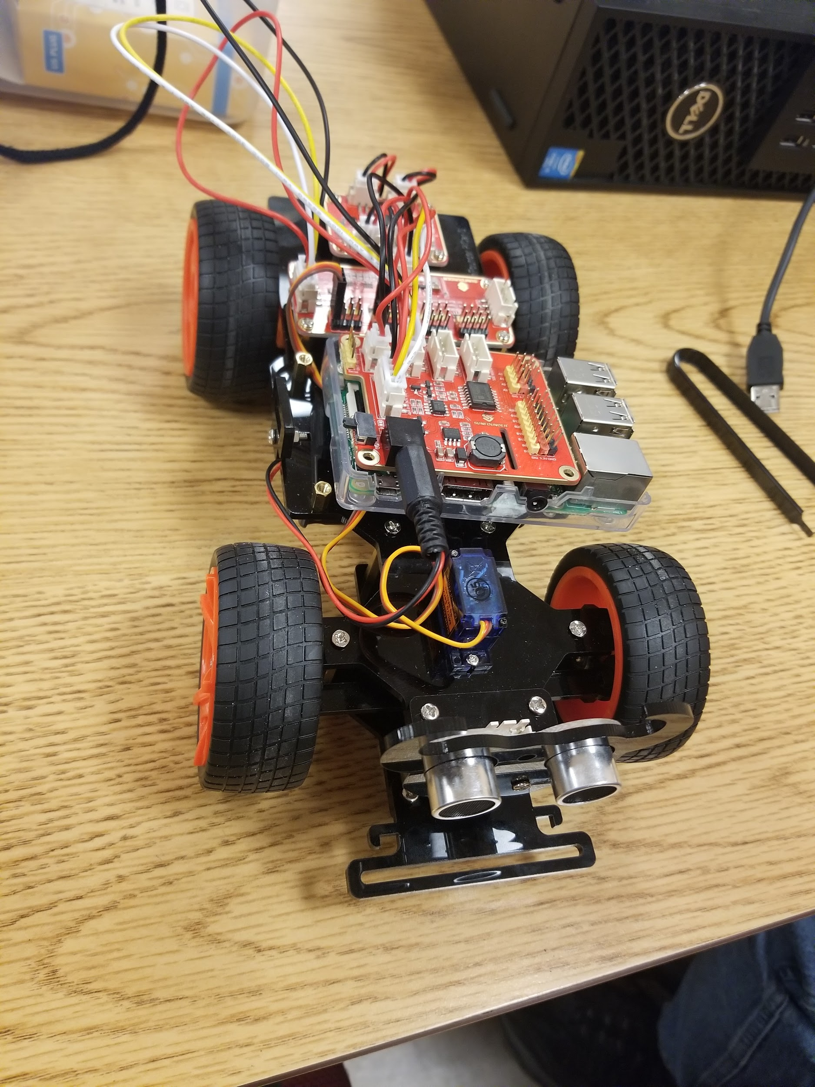
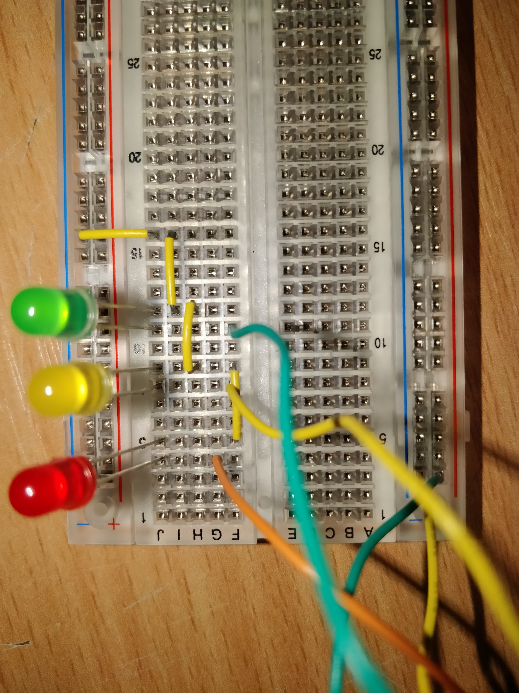

Slide 9
Demonstration
https://drive.google.com/open?id=1rHVK_lsVeQ4m08D7GmcavkQB90CHwRMO

Slide 10

RESULTS
The traffic lights can successfully connect to the broker
The MQTT can cycle the signals received
The Pi car can interpret the signals but the car has problems connecting to MQTT from python errors

Slide 11
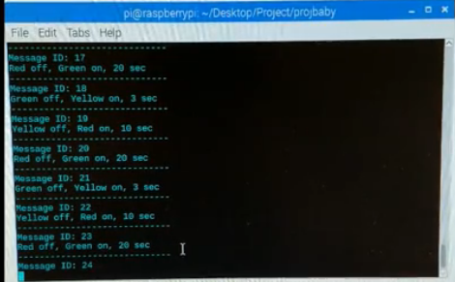
Evaluation
The code conversions caused connection problems
The code correctly posted to the broker
As more python knowledge is gained these problems can be solved

Slide 12

Limitations
The GPS sensor was not accurate enough
Libraries needed to be constantly reset
Raspberry Pi Car wheels where not stable
Prior python knowledge
http://blog.datacracker.com/diagnosing-customer-experience-problems-with-market-research-and-doing-it-cheaply/

Slide 13
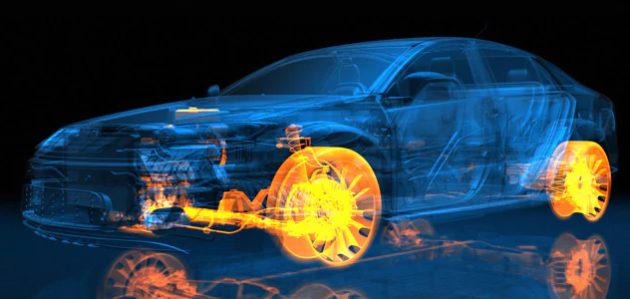
Future uses:
Develop more IoT systems in the Automotive industry
Less traffic accidents
Opportunities for other IoT applications
https://www.ibm.com/internet-of-things/explore-iot/vehicles/automobiles

Slide 14


